Slide 1
Model Calibration

Slide 2
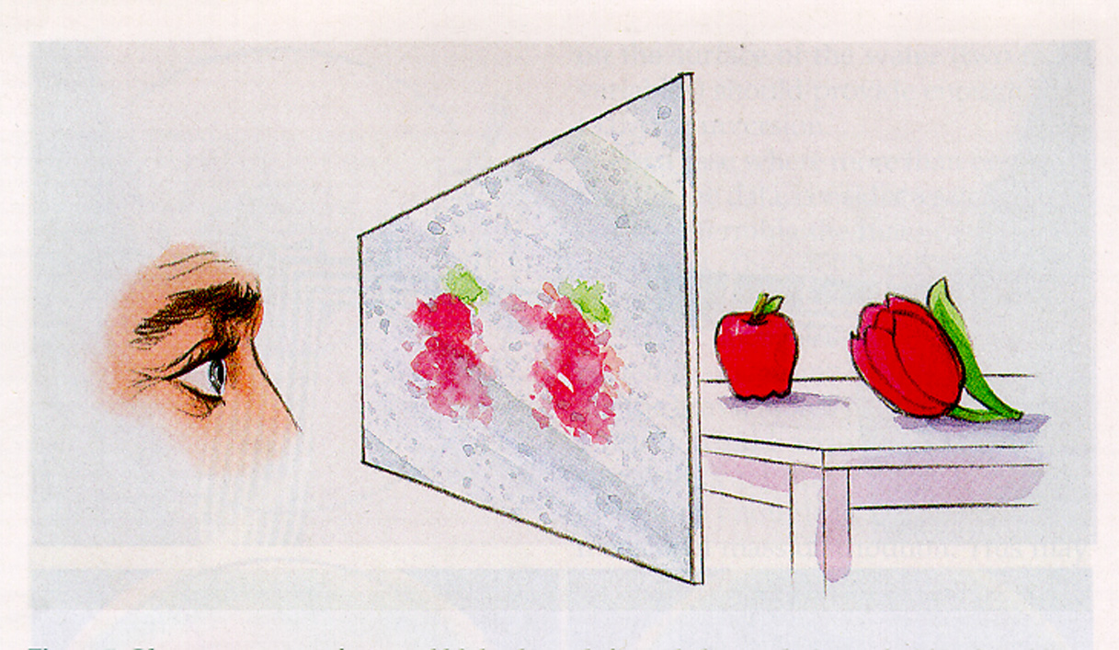
Estimating parameters is a nonunique inference process

Slide 3

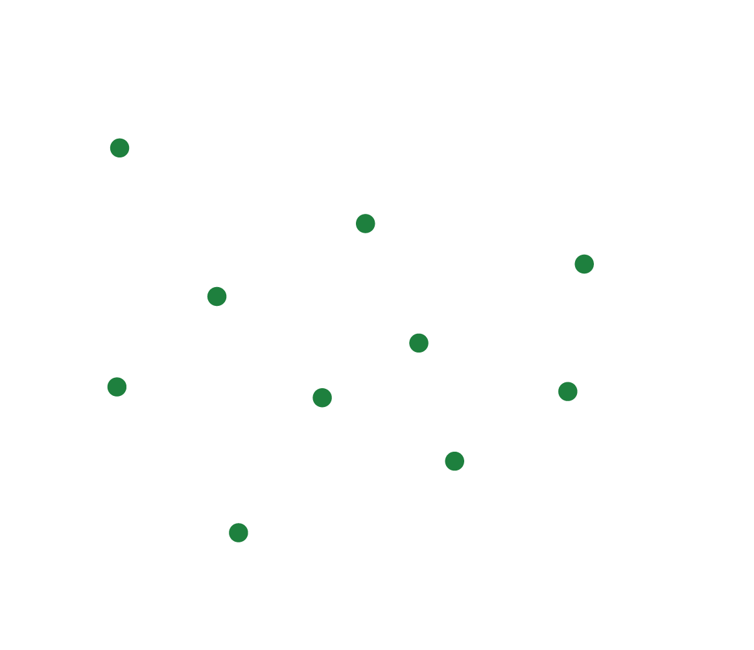
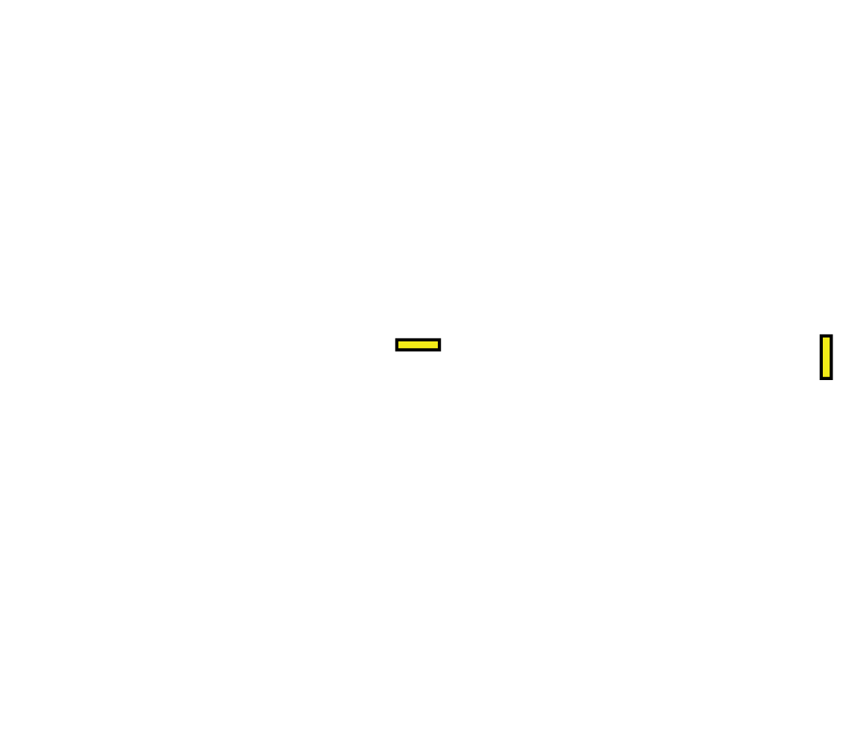
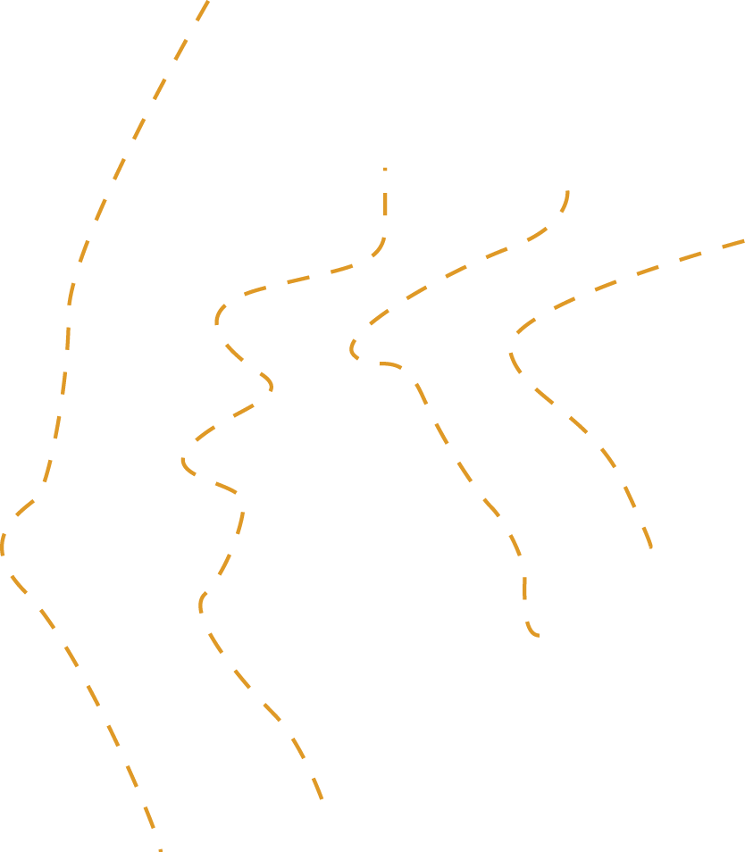


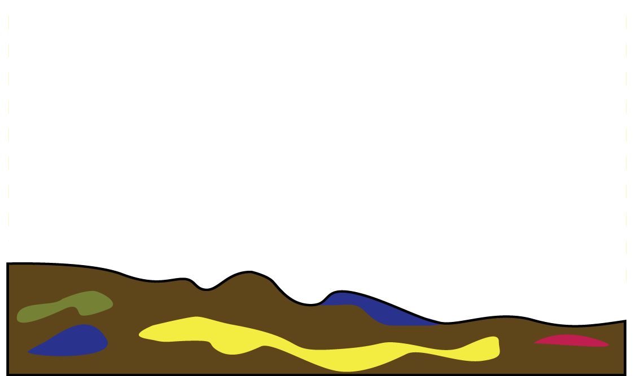
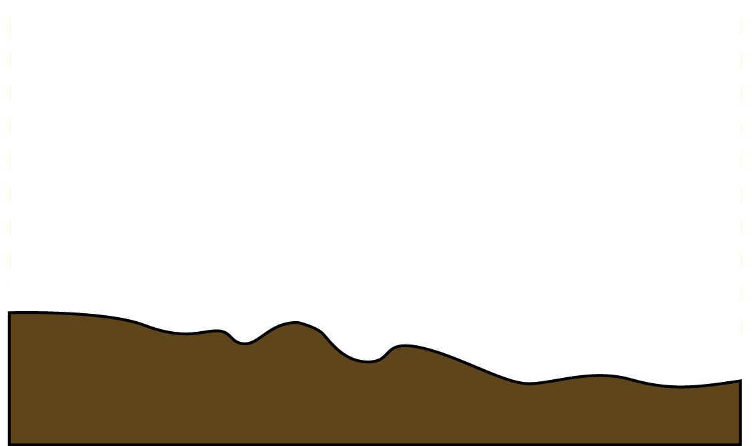

Calibration and Uncertainty
K
R
Notes:
3

Slide 4

Calibration and Uncertainty
More complex models → many parameters
Beyond Trial-and-Error → robust statistical techniques can help
Each parameter has some uncertainty associated with it
Predictions made using the model and these parameters will also have uncertainty to consider.
R
R
R
R
R
R

Slide 5
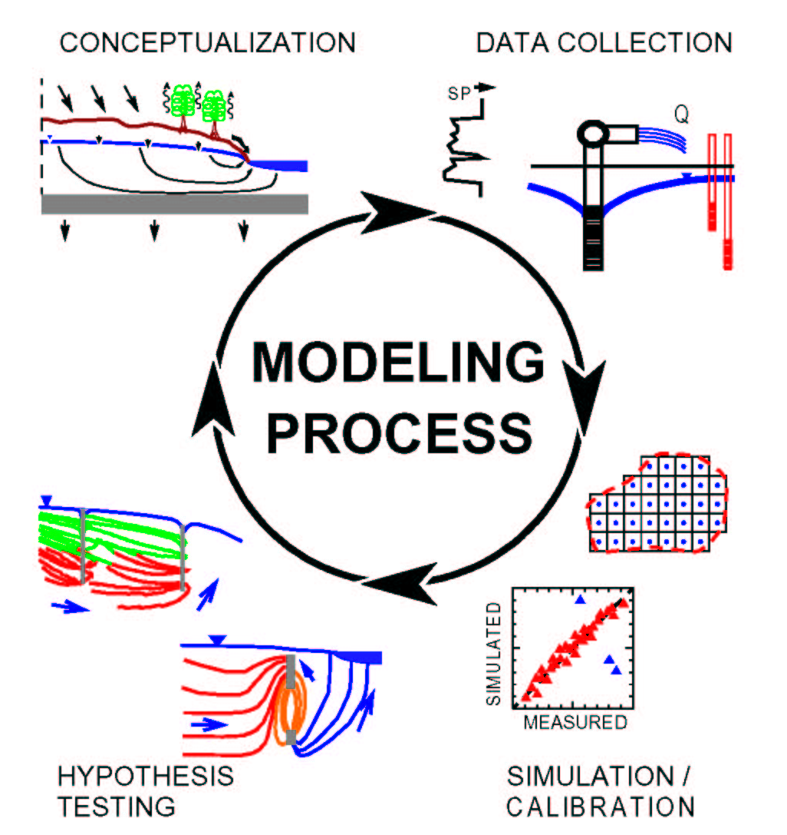
Model Calibration Concept
By K.J. Halford, 1991

Slide 6
Types of Observations
Heads and head differences
Flows and seepage runs
Groundwater age
Concentration
Temperature
Pathlines
Others

Slide 7
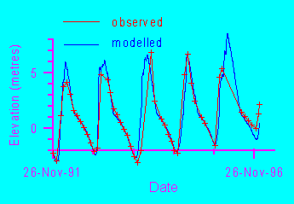
Residuals
Difference between a simulated value and its observed counterpart
For transient models, there may be many different measurements at the same location

Slide 8
Measures Of Goodness Of Fit
Weighted residuals (sum of squared errors)
Mean error (ME)
Mean absolute error (MAE)
Root mean squared (RMS) error
Nash-Sutcliff model efficiency (NS)
The distribution of residuals
Qualitative comparison of the observed and simulated contoured head surface

Slide 9
ME and MAE

Slide 10
RMS and NSE

Slide 11
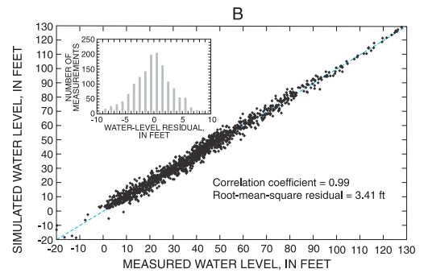
Residuals
-
+
-
+
-
+
+
-
Random distribution (good)
-
-
-
-
+
+
+
+
Non-random distribution (not good)

Slide 12
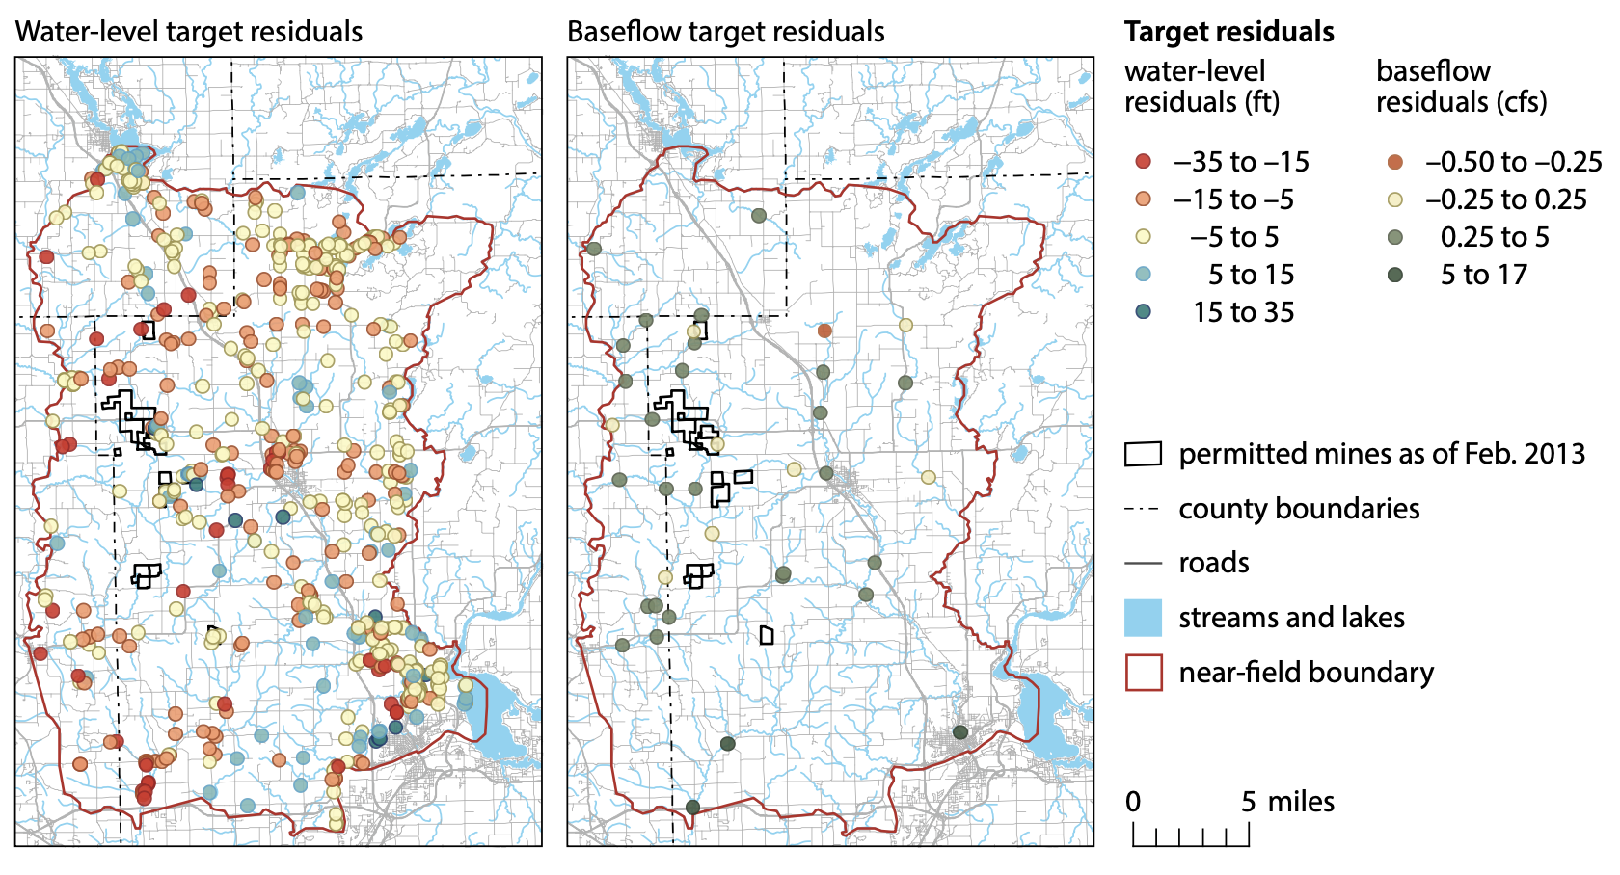
Residuals

Slide 13
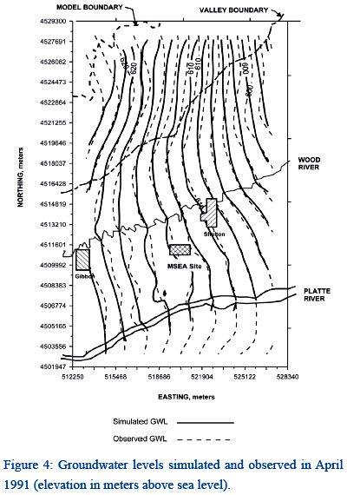
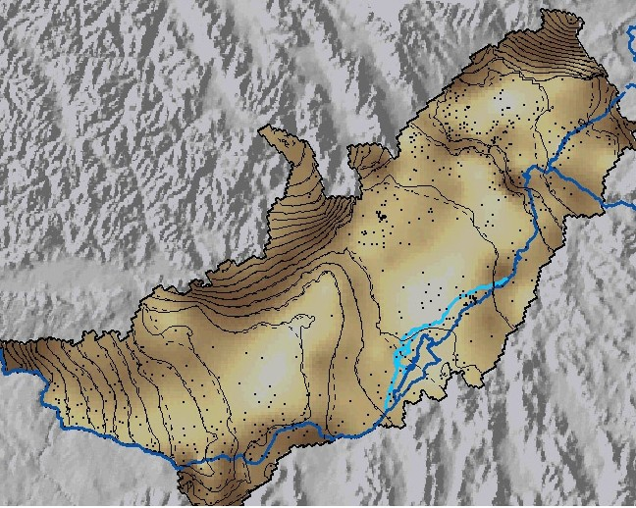
Qualitative Contour Comparison

Slide 14
Model Parameterization
Zones
Highly parameterized
Pilot Points
Geostatistical generating functions
Grid-based parameters

Slide 15
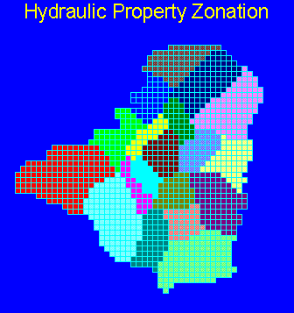
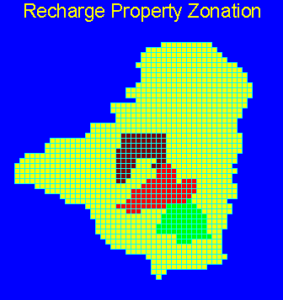
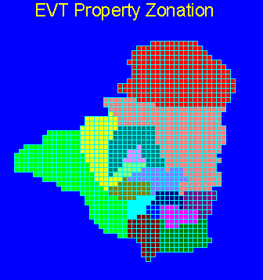
Zone Parameterization

Slide 16
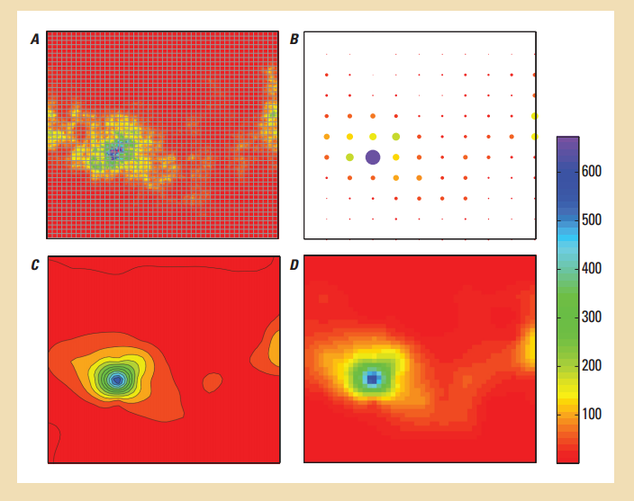
Pilot Point Parameterization

Slide 17
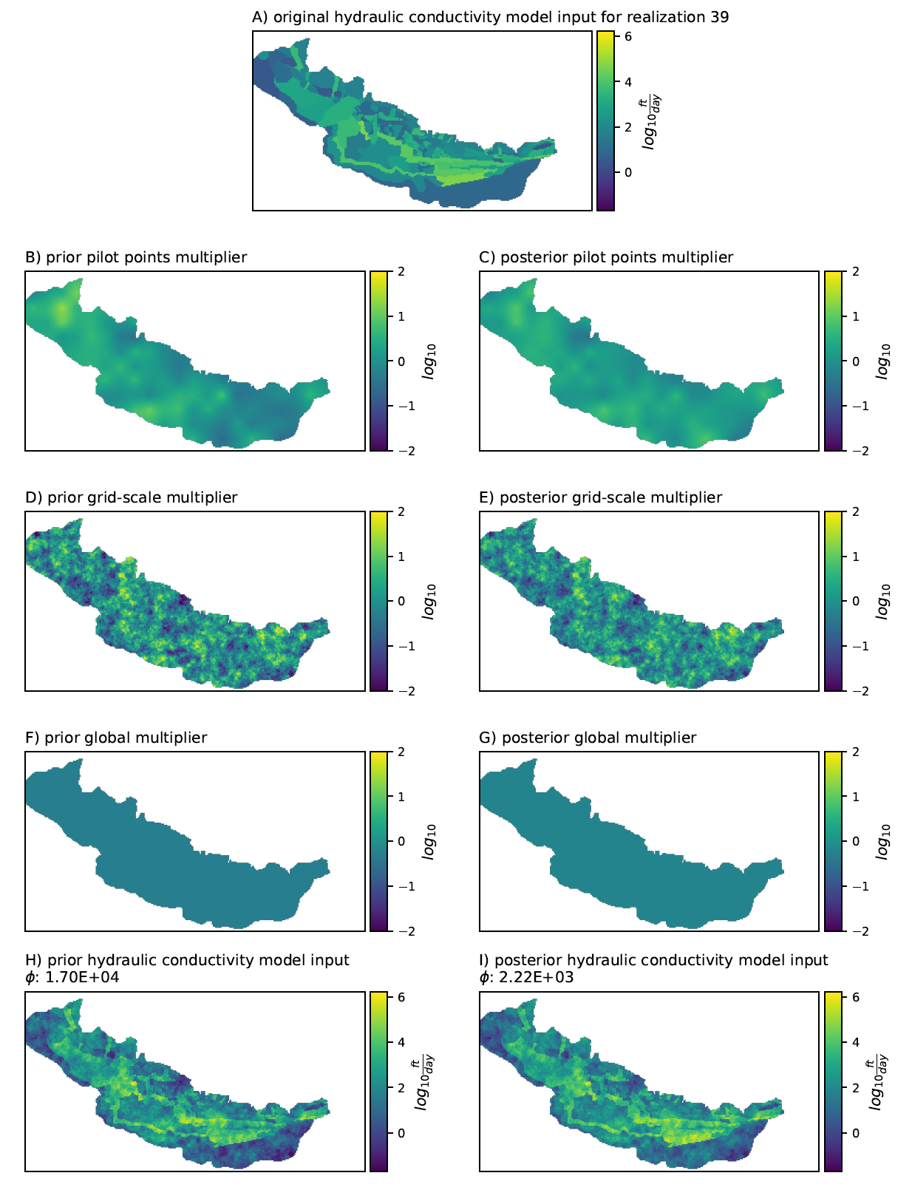
Multi-Scale Parameterization

Slide 18
Parameter Estimation Approaches
Trial and error
“Automated” parameter estimation
PEST++
PEST
A Bayesian approach merges these two

Slide 19
Trial and Error
Group like-type parameters into coarse zones
Manual adjustment of parameters within reasonable limits in order to improve match between observed and simulated values

Slide 20
“Automated” Parameter Estimation
Aka History Matching
Two different categories
Overdetermined: more observations than parameters
Underdetermined (highly parameterized): may have more parameters than observations. Requires additional information.
Neither are really automated!

Slide 21
Automated Parameter Estimation
The concept:
HEAD
HYDRAULIC CONDUCTIVITY

Slide 22
Automated Parameter Estimation
Application to many parameters and observations:
NOBS
NPAR

Slide 23
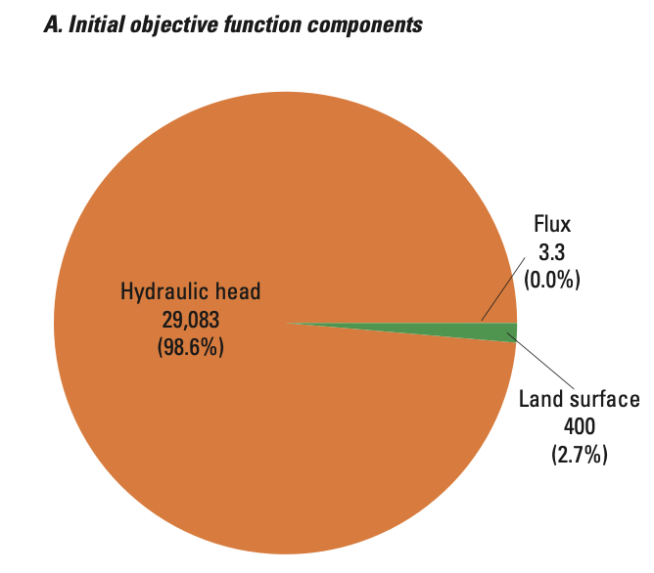
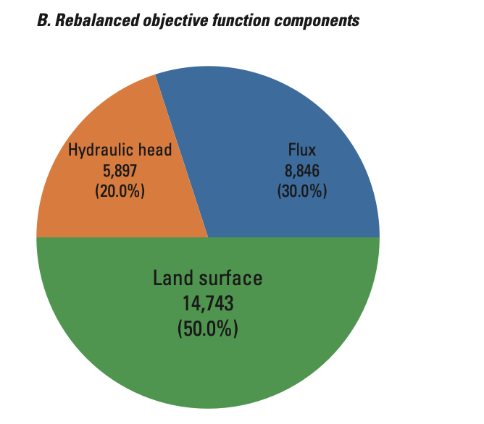
Automated Parameter Estimation
Sum of squared weighted residuals:

Slide 24
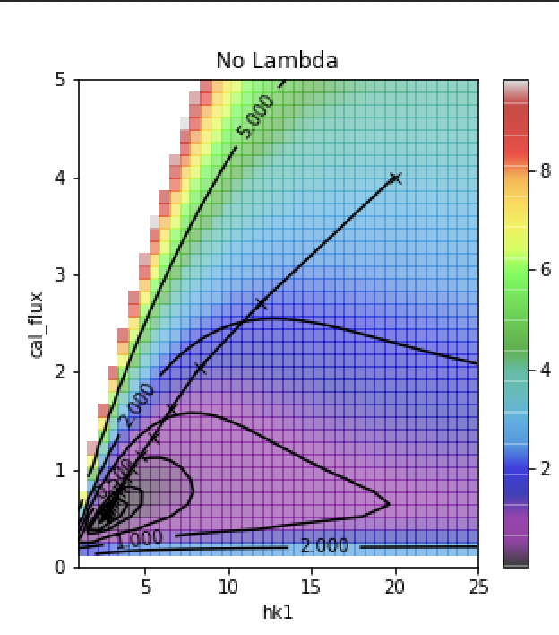
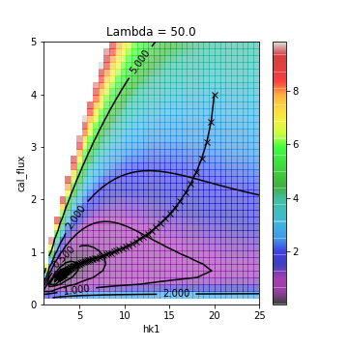
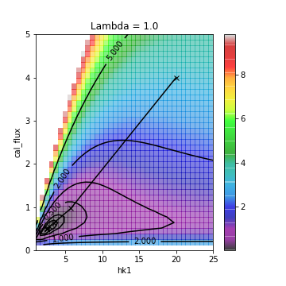
Automated Parameter Estimation
Non-linear parameter estimation (response surface and Marquardt Lambda):

Slide 25
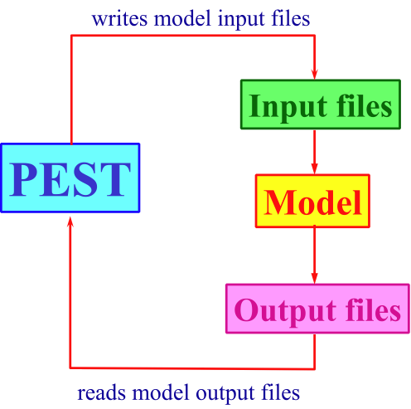
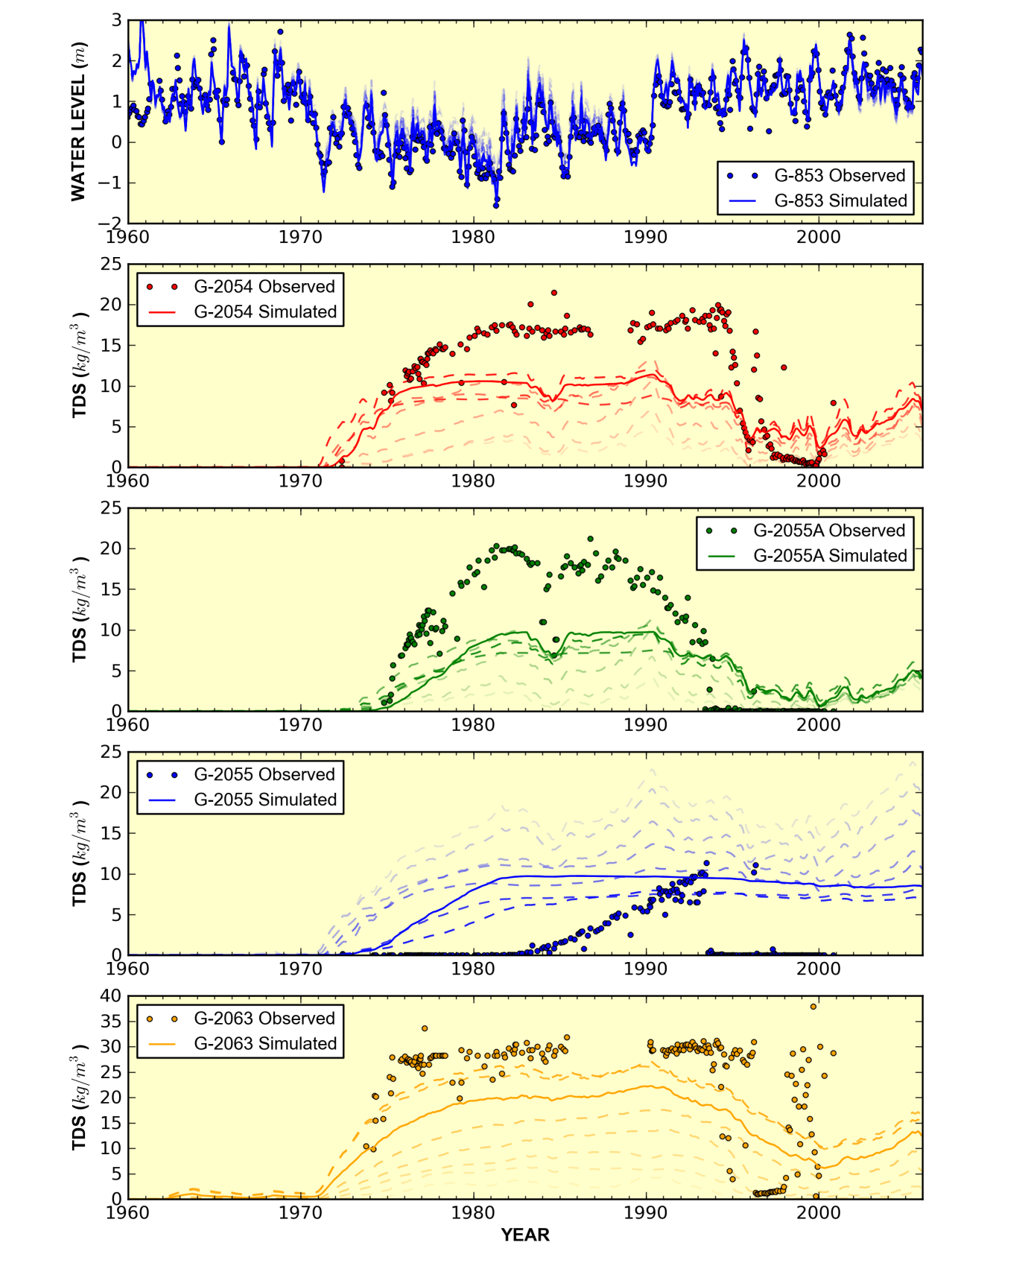
Automated Parameter Estimation
Execution procedure:

Slide 26
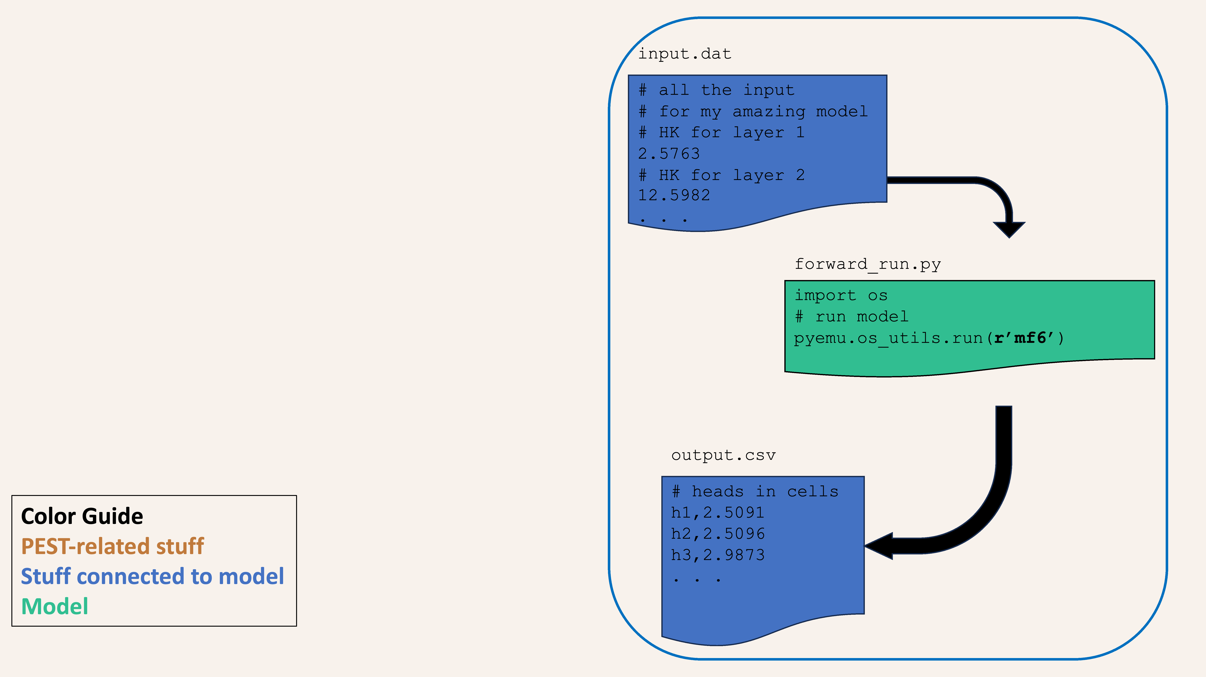
PEST – a model-independent option

Slide 27
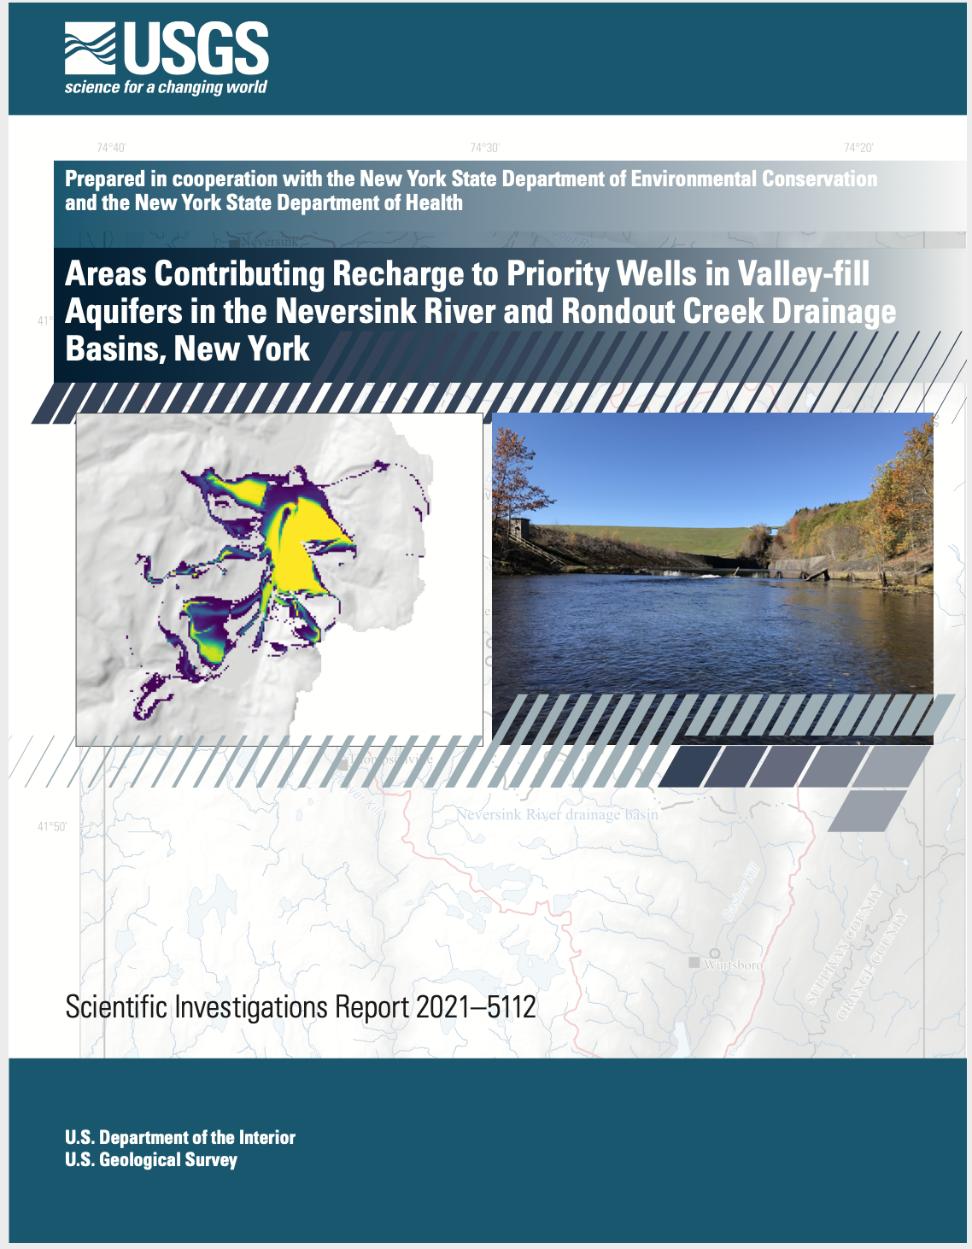
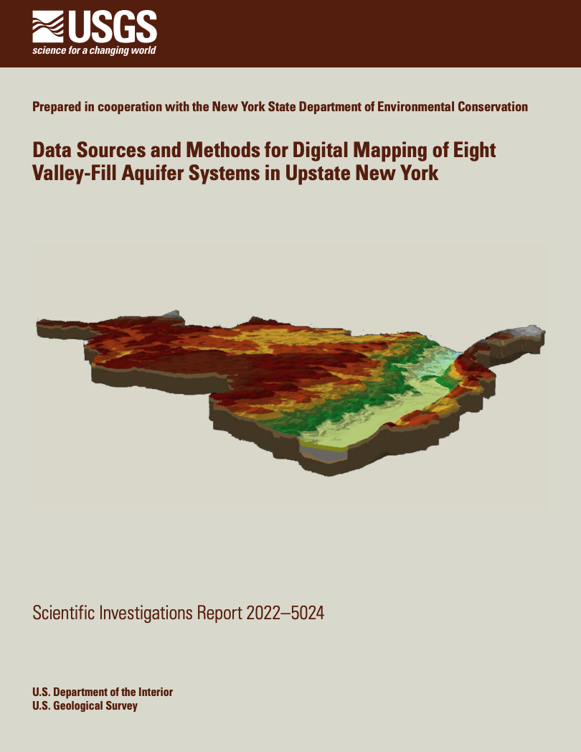
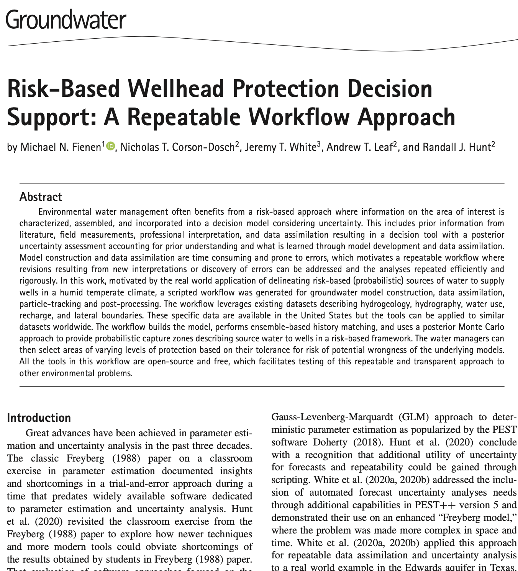
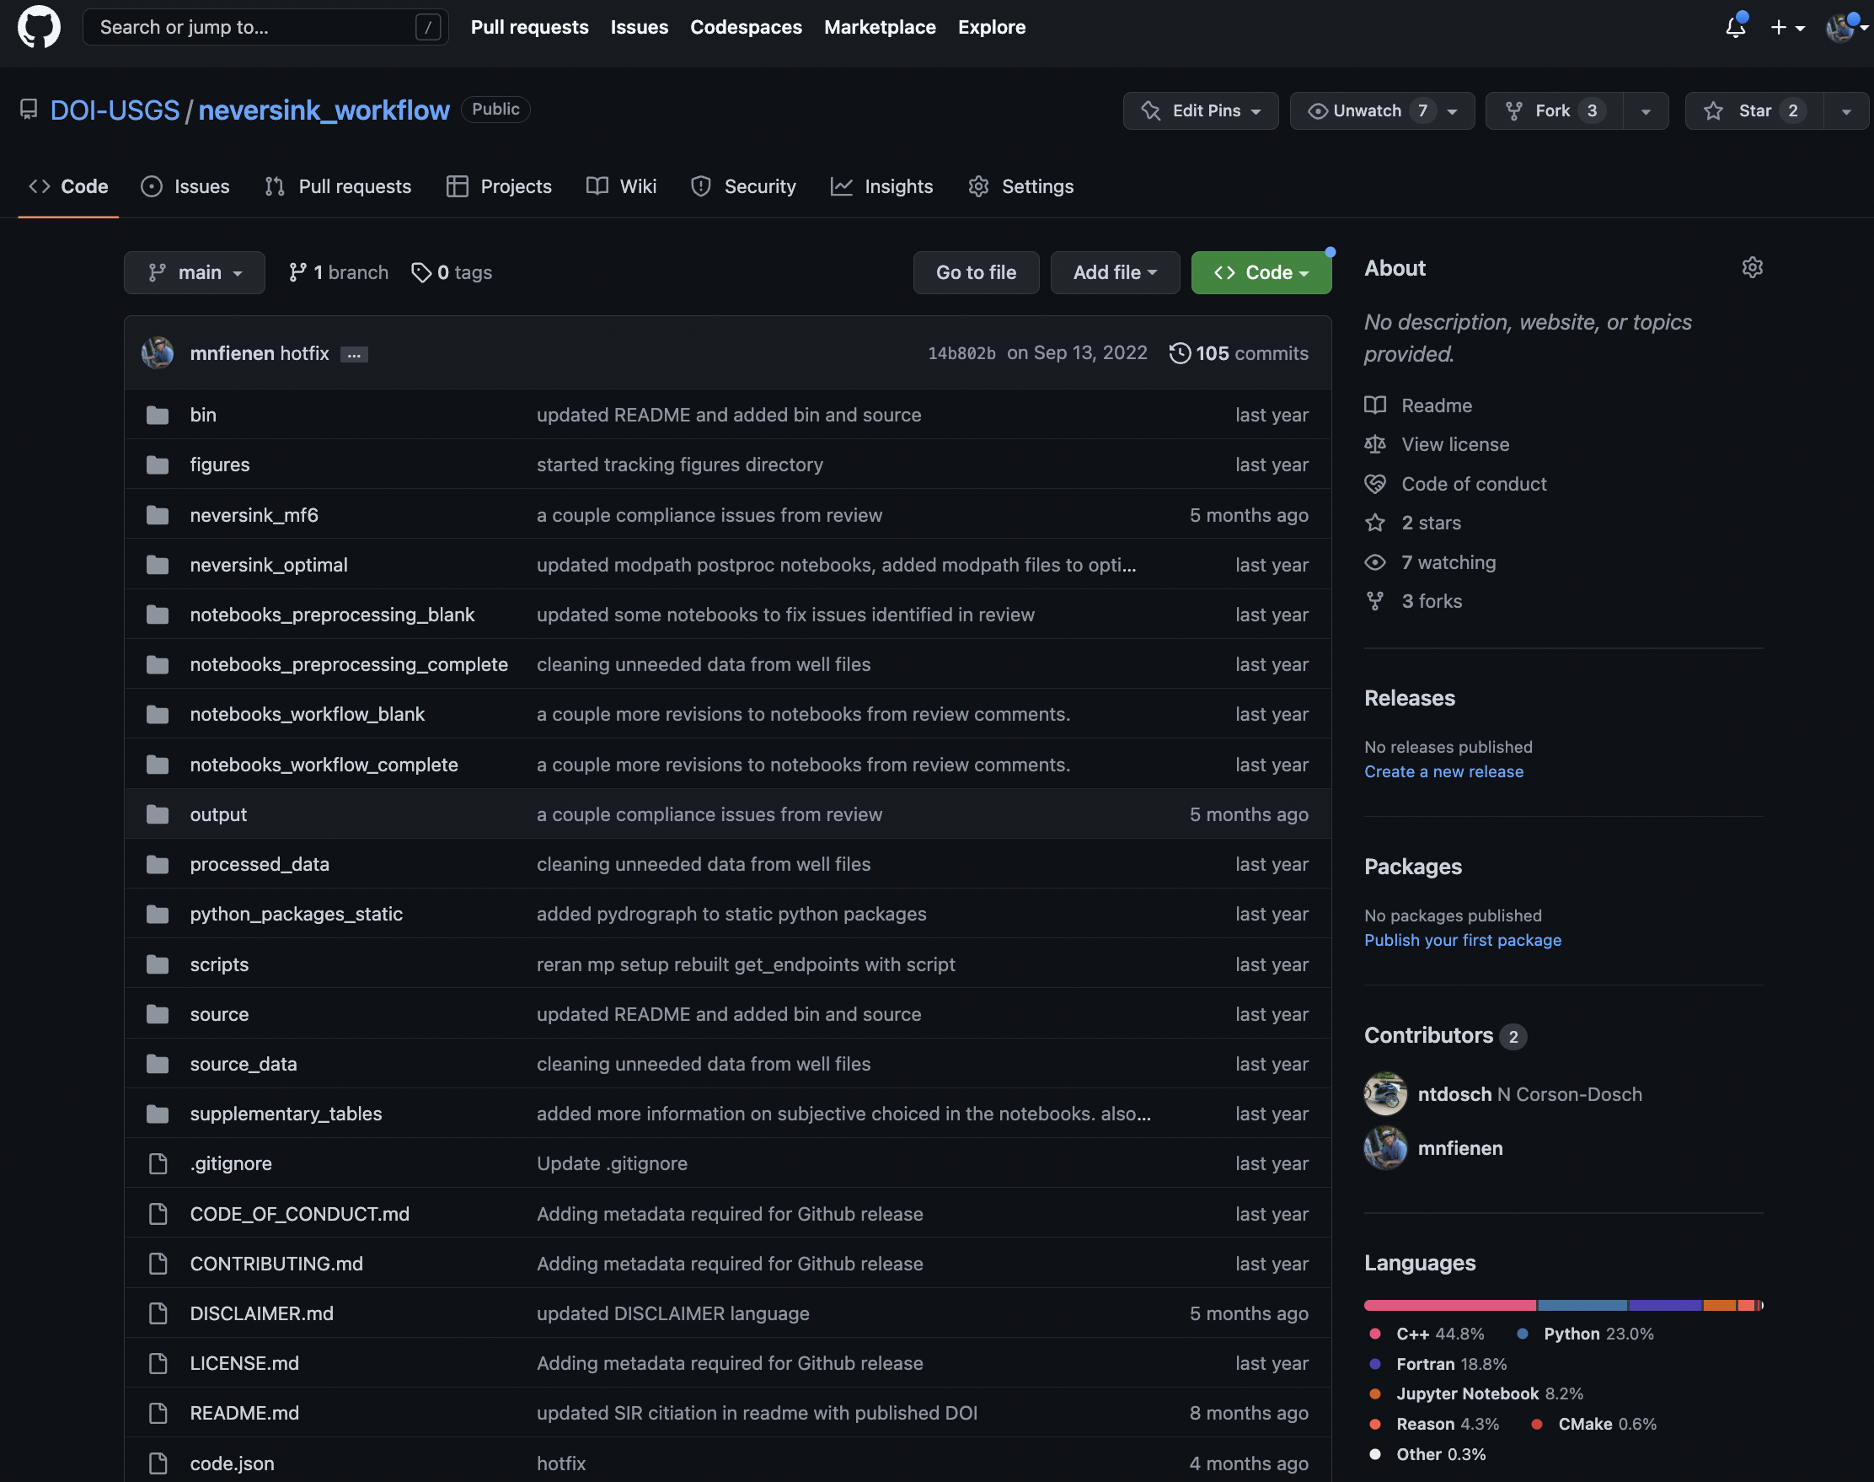
Parameter Estimation Examples
Probabilistic Capture Zones for the Rondout-Neversink basins in New York
https://doi.org/10.3133/
sir20215112
https://doi.org/10.3133/
sir20225024
https://doi.org/10.1111/
gwat.13129
https://github.com/DOI-usgs/
neversink_workflow

Slide 28
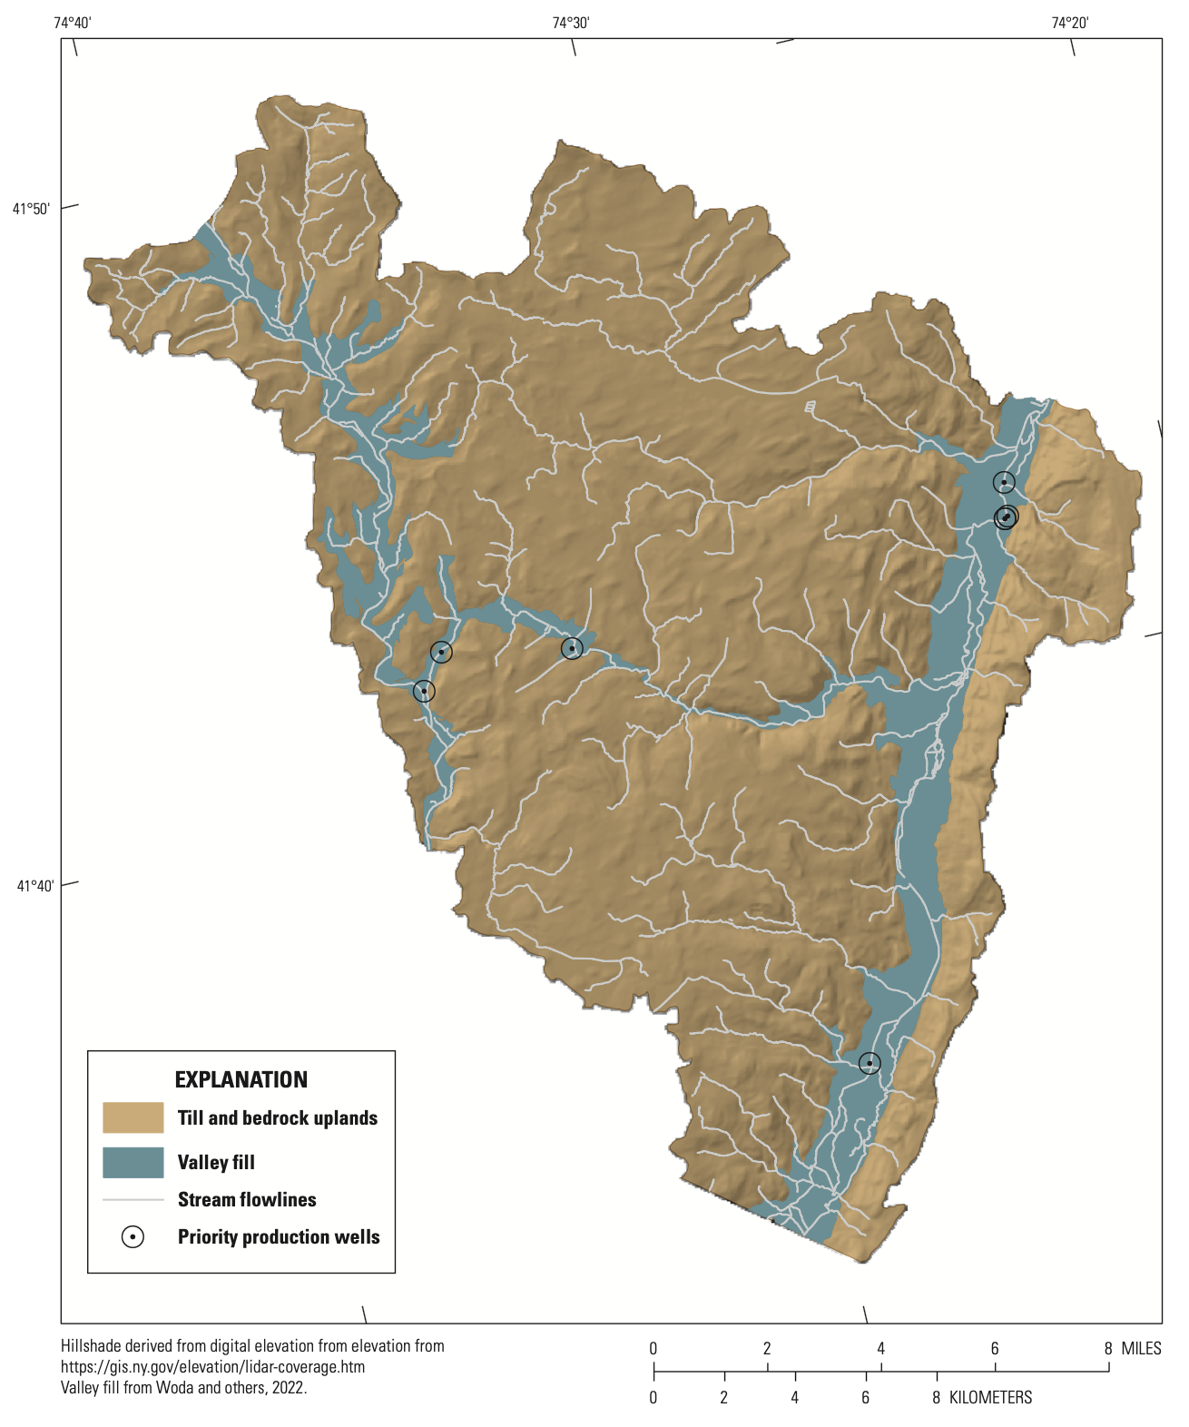
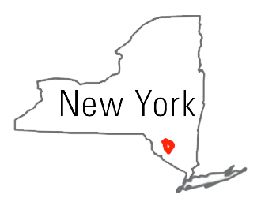
Parameter Estimation Examples
Risk-based decision-support system for wellhead protection in a glacial aquifer in the the Neversink-Rondout Basin, New York
Making a Bayesian update, incorporating observation information into a prior conceptualization

Slide 29
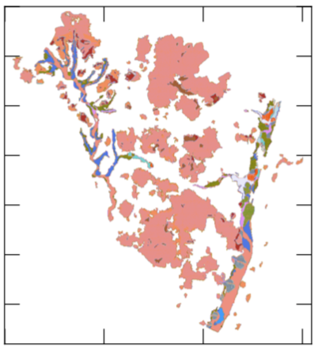
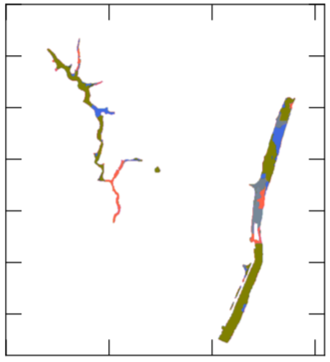
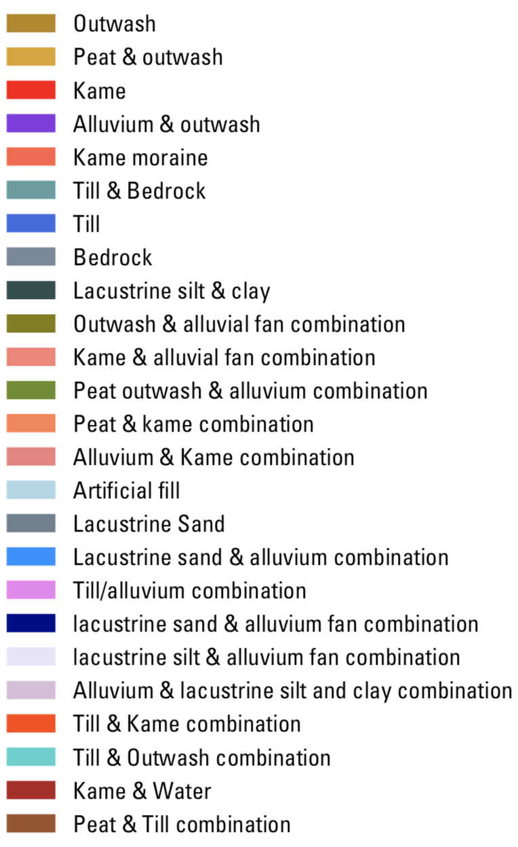
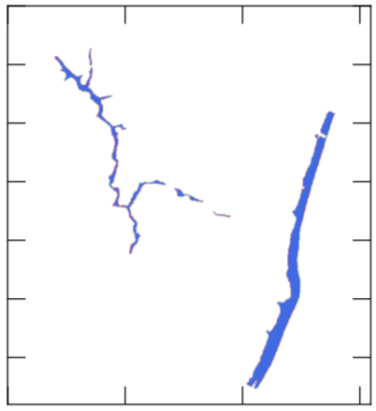
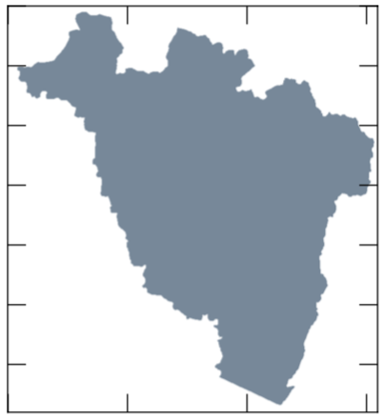
Model Calibration Examples
MODFLOW 6 ---
removing
inactive cells
Sped up execution 92% #wat?
Layer 1: All Lithologies
Layer 2: Glacial
Layer 3: Glacial
Layer 4: Bedrock

Slide 30
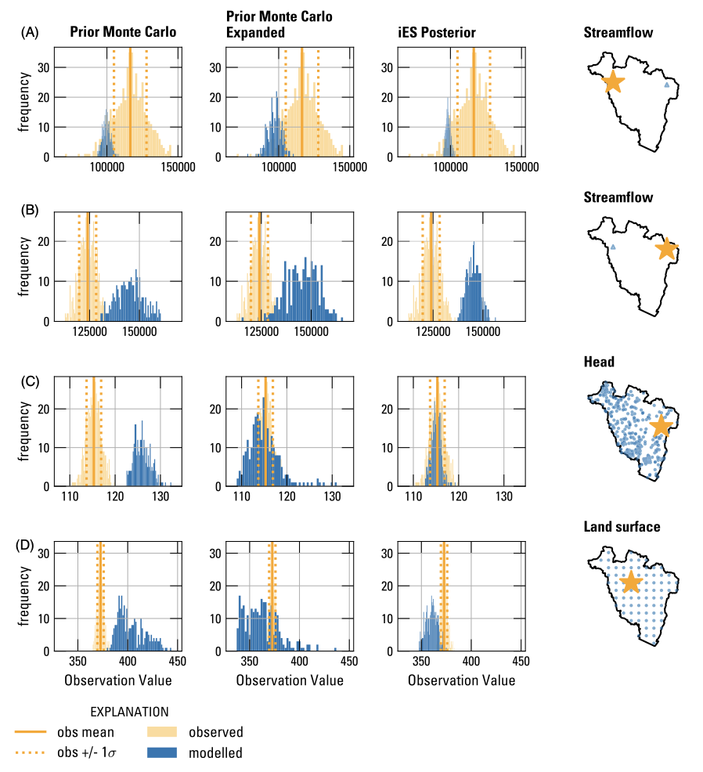
Model Calibration Examples

Slide 31
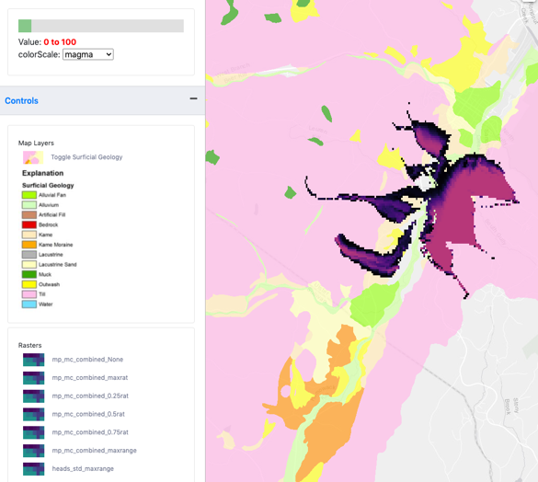
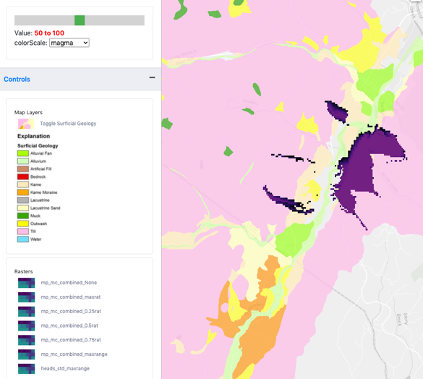
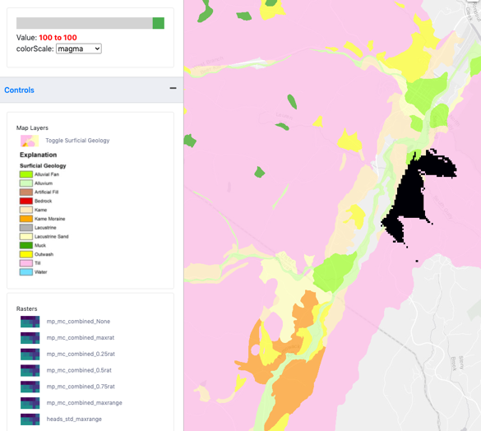
Risk-Based Decision Support Tool
Risk averse
Risk neutral
Risk tolerant

Slide 32
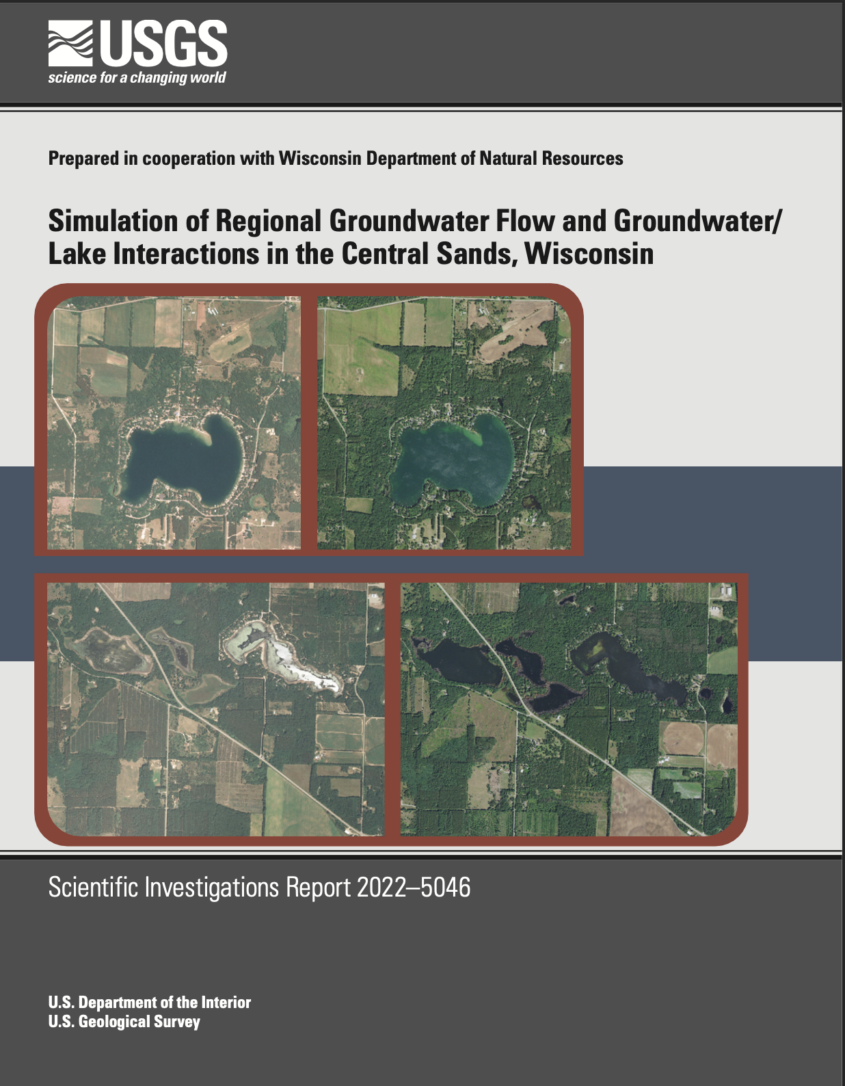
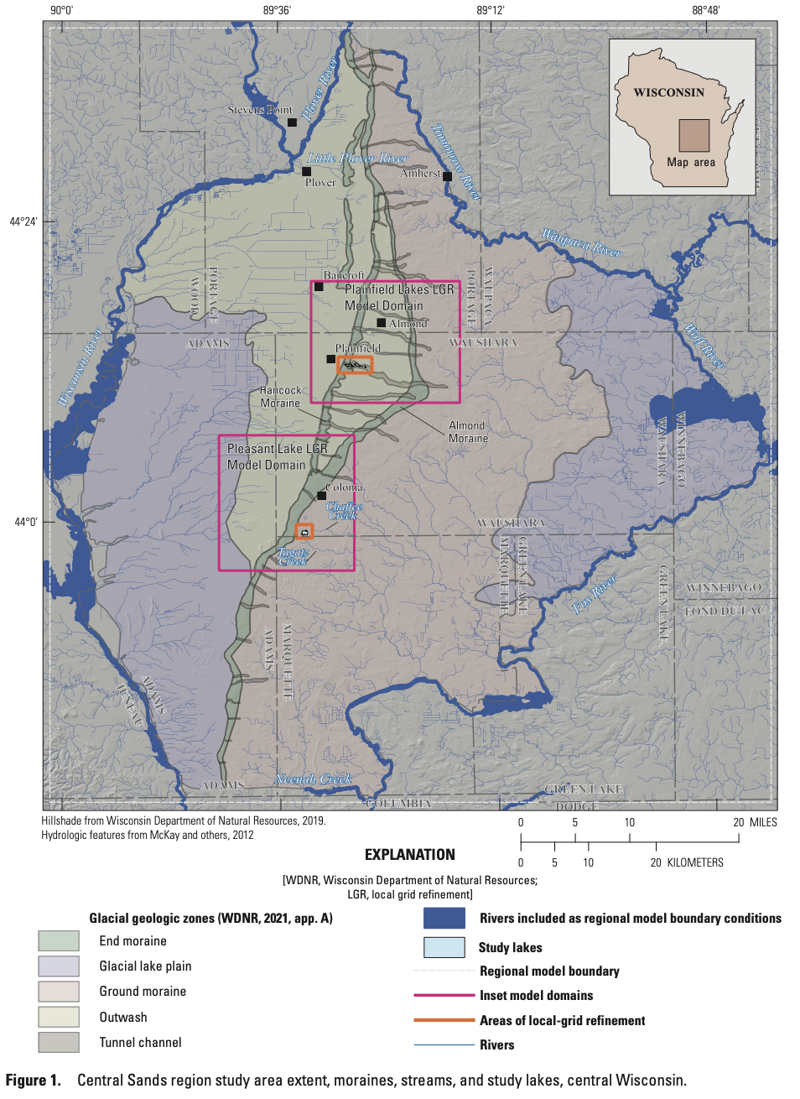
Model Calibration Examples

Slide 33
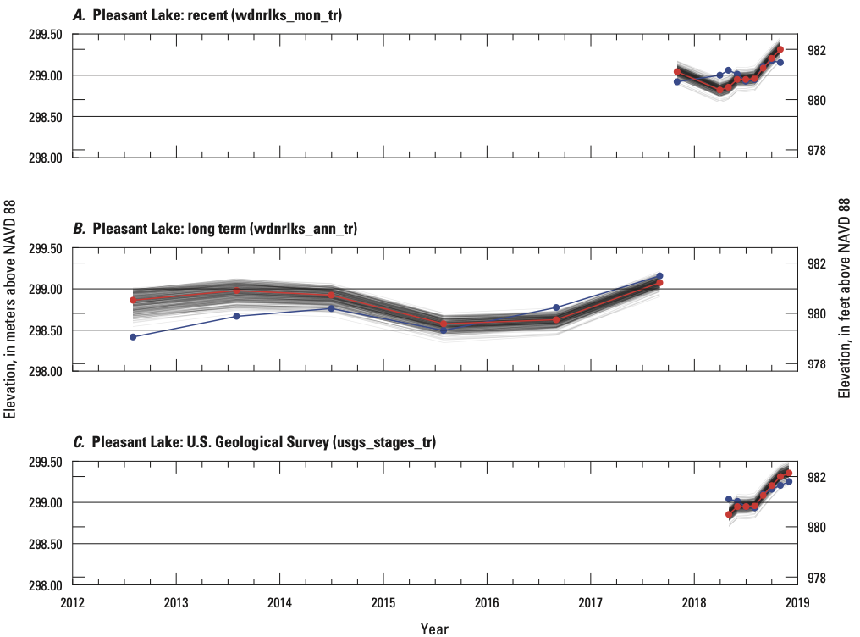
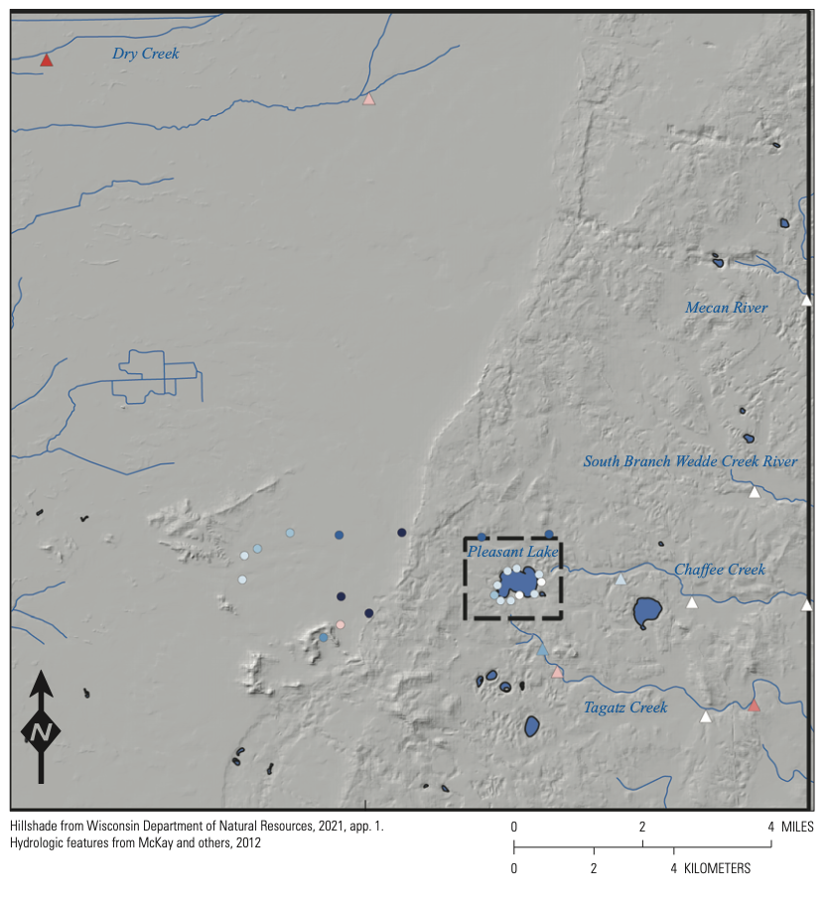
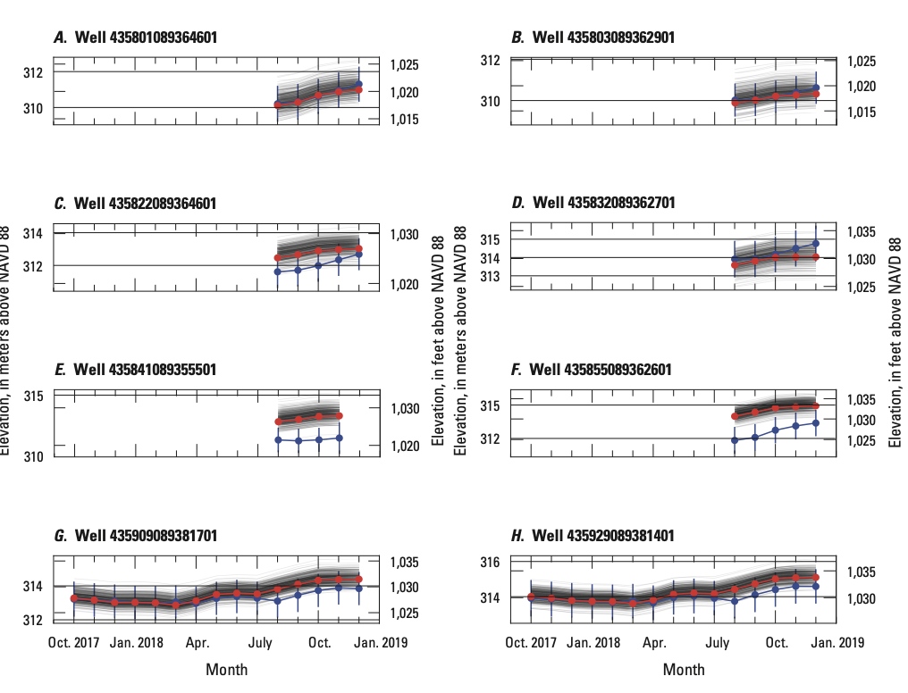
Model Calibration Examples – cont.

Slide 34
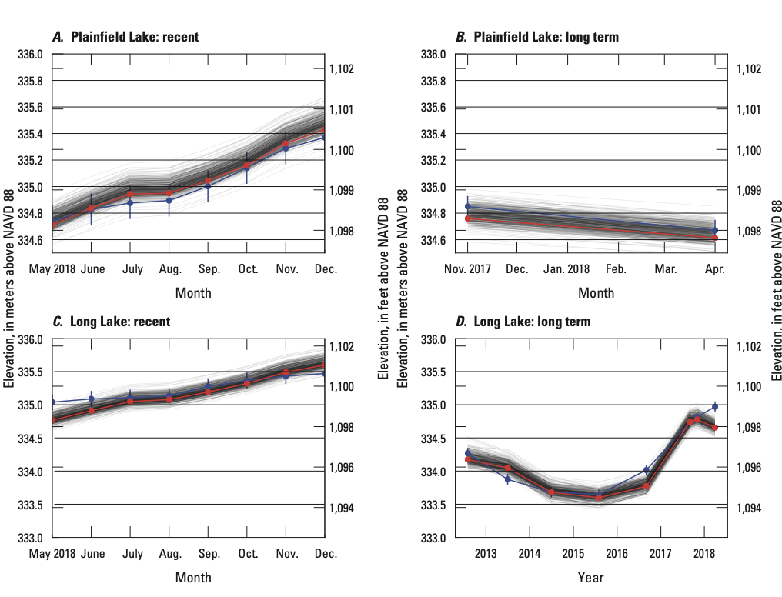
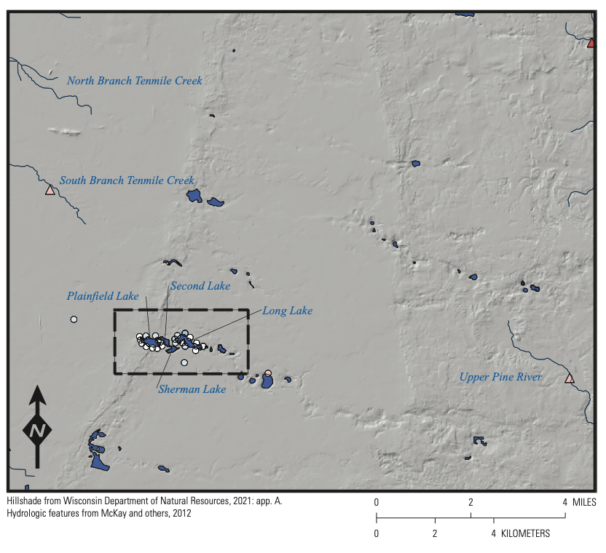
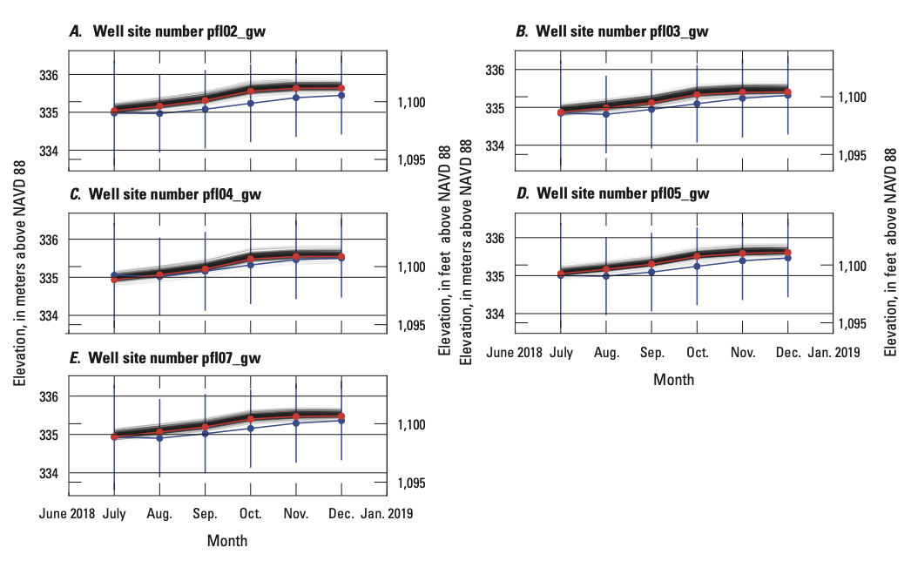
Model Calibration Examples – cont.

Slide 35
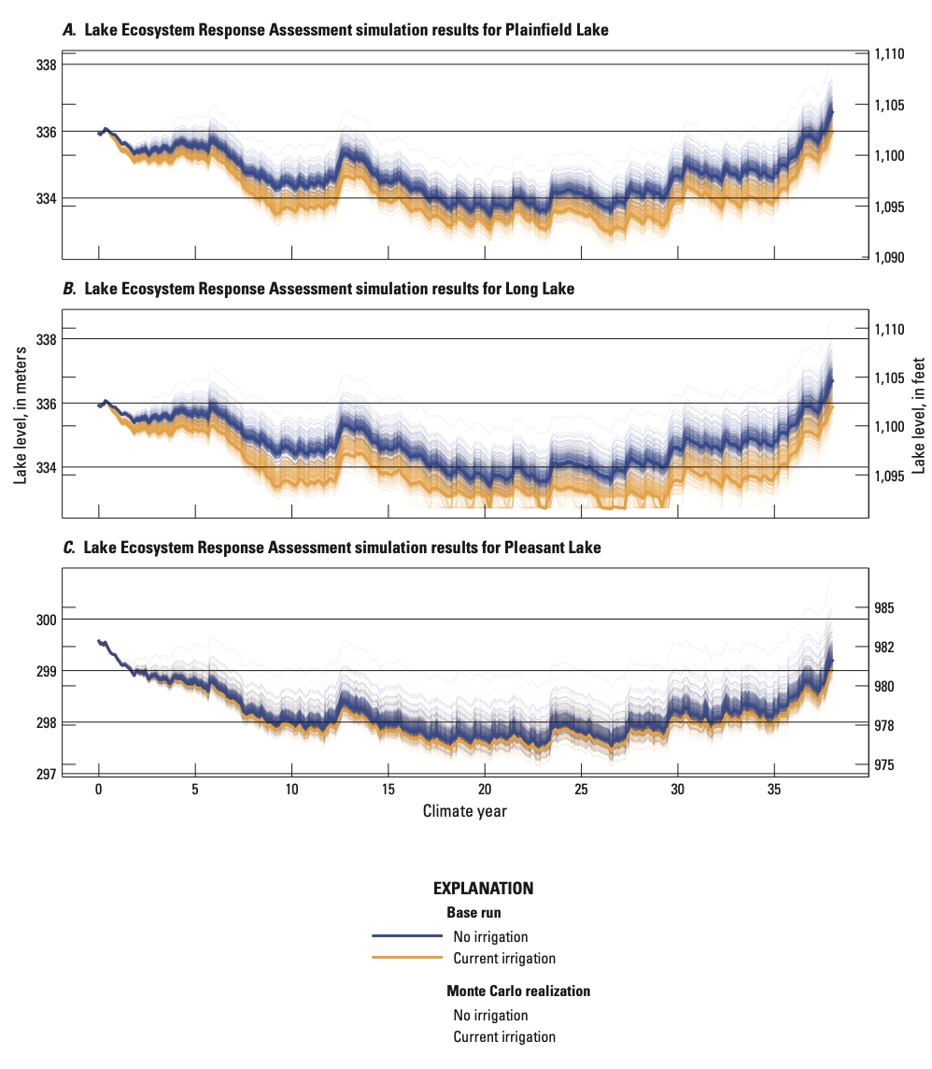
Model Calibration Examples – cont.

Slide 36
Concepts To Keep In Mind
Compare multiple observation types (for example, heads, flows, concentrations)
Continuously re-evaluate the system conceptualization – boundary conditions, framework, etc.
Try to understand the sensitivity of the system to different parameters and boundaries
We are trying to make a simplified mathematical copy of the real world

Slide 37
Calibration is but one part of our attempt to understand and duplicate the actual system in a numerical model.
WARNING:
“… a model involving a wrong or incomplete conceptual model can be adequately calibrated.”
Bradehoeft, J.D, 2003, From models to performance assessment: the conceptualization problem. Ground Water, v. 41, no. 5, 571-577, DOI: 10.1111/j.1745-6584.2003.tb02395.x.

Slide 38
USGS Modeling Report Components
A description of the natural system.
A description of the numerical counterpart with the model input fully documented.
A convincing argument that the numerical model is a plausible representation of the natural system.

Slide 39
Some resources
PEST and PEST++: http://pesthomepage.org
pyemu: https://github.com/pypest/pyemu
tutorial notebooks: https://github.com/gmdsi/GMDSI_notebooks
Complete worked examples:
Neversink https://github.com/DOI-USGS/neversink_workflow
https://doi.org/10.3133/sir20215112
https://ngwa.onlinelibrary.wiley.com/doi/abs/10.1111/gwat.13129
Edwards aquifer: https://doi.org/10.5066/P9AUZMI7

